Slide 1
Promoting women in science, technology, mathematics and engineering (STEM)
February 21, 2017
Loyola University Medical Center -Maywood
Barbara Di Eugenio, PhD
Professor – University of Illinois at Chicago
VP for Finance – AWIS Chicago
Ana Shulla-Mesi, PhD
Senior Scientist-Abbott Diagnostics
Industry Liasion – AWIS Chicago

Slide 2
STEM Careers
Professional Development
Research
Administration
Academic
Research
Teaching
Science
Communication
Law
Policy
Regulatory
Technology Transfer
Business
of
Science
Industry:
Pharma
Biotech
Medicine
and
Healthcare
Entrepreneur
ship
Consulting

Slide 3
Why Women are Beneficial in the Scientific Workforce
Fortune 500 companies that have 3 or more female directors have seen benefits.
66% increase in return on invested capital
42% increase on return on sales
53% increase on return on equity
22% lower turnover rate
Diversity results in greater stockholder value, improved financial performance, and better decision making in teams
Association for Women in Science – Factsheet. Forbes.com "A Quick Glance At The Biotech IPO Boom" by Matthew Herper, Forbes Sta . 8/13/13. http://www.forbes.com/sites/matthewherper/
2013/08/13/a-quick-glance-at-the-biotechipo- boom/#; http://www.nasdaq.com/markets/ipos/; http://www. ercebiotech.com/special-reports/biotech-ipo-frenzy-headed-crack; http://anitaborg.org/wp-content/uploads/2014/03/The-Case-for-Investing-in-women-314.pdf; woolley,a.w., chabris, c.f., et al (2010). Evidence for acollective intelligence factor in the performance ofhuman groups. science, 330, 686-688.Government Equalities O ce, conducted by Ipsos MORi, sample of 1,071 adults in Great Britain aged 16+. 20-24 February 2010,published 11 March 2010.

Slide 4
Challenges that Women in STEM Face Today
Women have been earning more than 50% of the degrees in some STEM PhD subjects for many years, yet the numbers reflected in leadership in academia and industry fail to reflect these advances.
Women scientists are underrepresented in university technology transfers, holding only 10% of the patents in the US.
There are a variety of reasons women slowly leak out of the pathway to leadership, including bias, lack of promotion opportunities, lack of recognition, and lack of mentors and sponsors.
Another challenge that nearly all women scientists face is finding the proper work-life balance, between pursuing an academic or industry career and raising a family.

Slide 5
Association for Women in Science (AWIS) – A Resourceful Solution
Founded in 1971
It is the largest multi-disciplinary organization for women in science, technology, engineering, and mathematics (STEM)
Champions the interests of women in STEM:
Compensated fairly and without discrimination
Advanced equitably and without bias
Exposed to successful role models in leadership positions
Recognized and respected for their scientific and leadership achievements
There are 22 Chapters and 26 Chapter Affiliates Nationwide
AWIS reaches 20,000 professionals in STEM each month

Slide 6
Member Benefits
AWIS Magazine: 4 issues per year
Washington Wire: 24 issues per year
AWIS in Action: 12 issues per year
STEMiNARS©: 12-15 per year
Work/Life Satisfaction Program
Website resources including recorded webinars
Online membership directory
Free access to MentorNet (online mentor match)
Chapter networking and professional development

Slide 7
AWIS Chicago Chapter
Formed in 1978, one of the first chapters; 5th-largest chapter since 2012 (70+ active members)
Provides a platform for connection, communication, career development and support for women at all career stages in the Chicago-land area
Notes:
graduate students, retirees, post-docs, professionals in academia, education, medical communication, venture capital, non-profit organizations and more

Slide 8
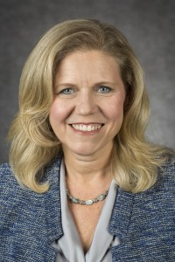
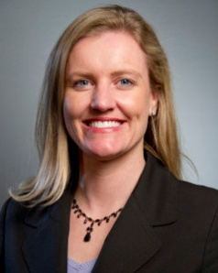
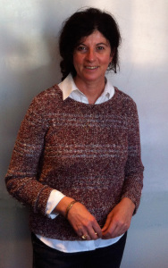
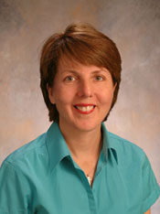
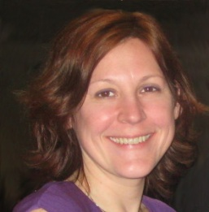
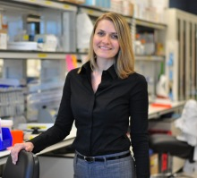
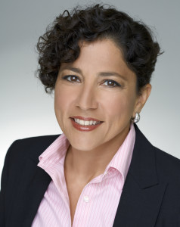
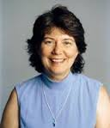
Honoring our very own Chicagoland scientists
Scientists of the Month
Dorothy Kozlowski
Suzanne Bell
Eileen Dolan
Kelly Fahrbach
Jelena Radulovic
Virginie
Buggia-Prevot
Dima Elissa
Joan Cook-Mills

Slide 9
AWIS Chicago Executive Board
President – Marina Damiano, PhD
Immediate Past President – Karen Chien, PhD
VP for Finance – Barbara Di Eugenio, PhD
Head Industry Liaisons Committee – Ana Shulla-Mesi, PhD
VPs for Outreach – Jessica Hoch, PhD
VPs for Communication – Rashi Rangaraj, PhD, Allison Zajak, PhD
VP for Membership – Andrei Halavaty, PhD, Aminatou Barry
Newsletter Editor – Karen Watters, PhD
Notes:
graduate students, retirees, post-docs, professionals in academia, education, medical communication, venture capital, non-profit organizations and more

Slide 10
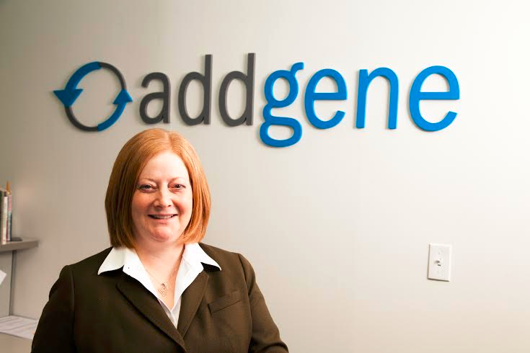
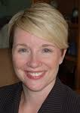
Science & Self Speaker Series
“Smooth Transitions: Taking the First Steps to a Fulfilling Career in Science”
Joanne Kamens, Ph.D.
Executive Director, Addgene
“Reclaim Your Time and Connect with Yourself”
Dana Samardzich
Optimal Balance Coaching

Slide 11
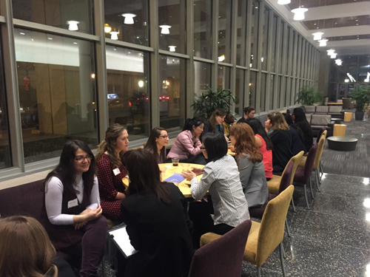
Speed Networking
Partner event with Northwestern University’s Association for Women in Chemistry

Slide 12
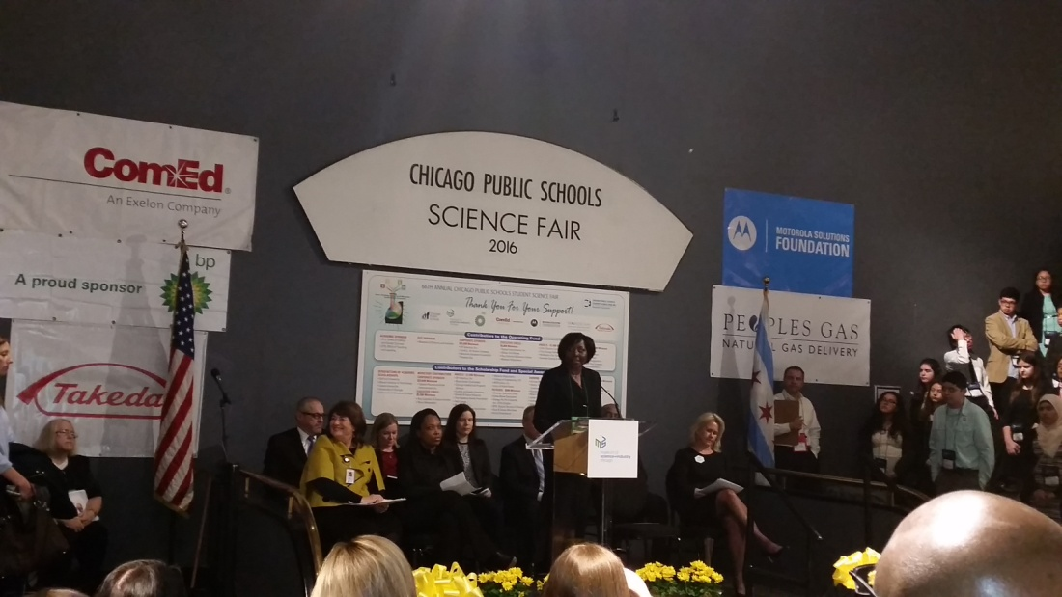
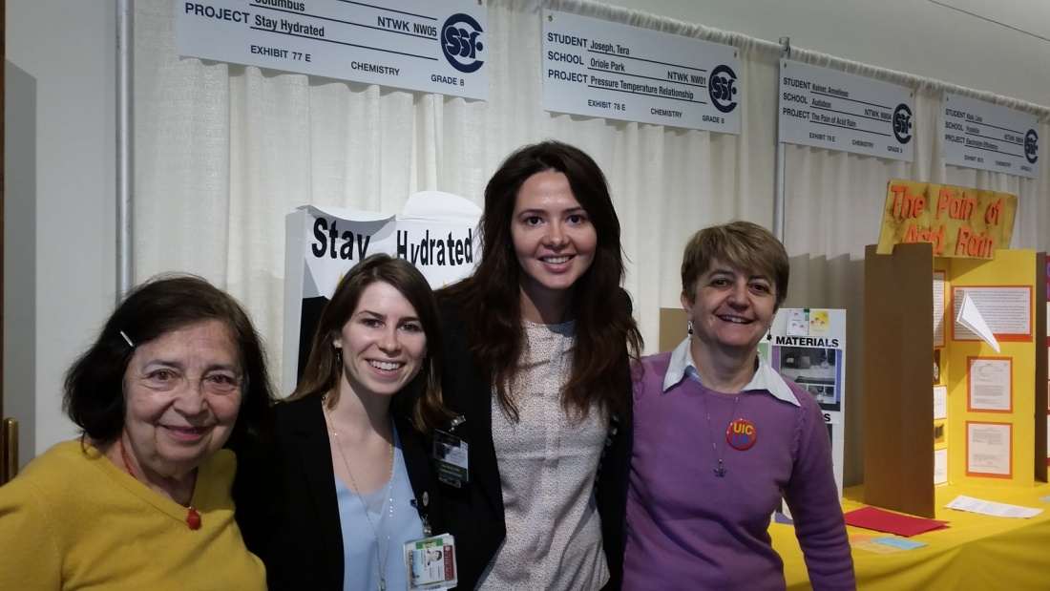
CPS Science Fair

Slide 13
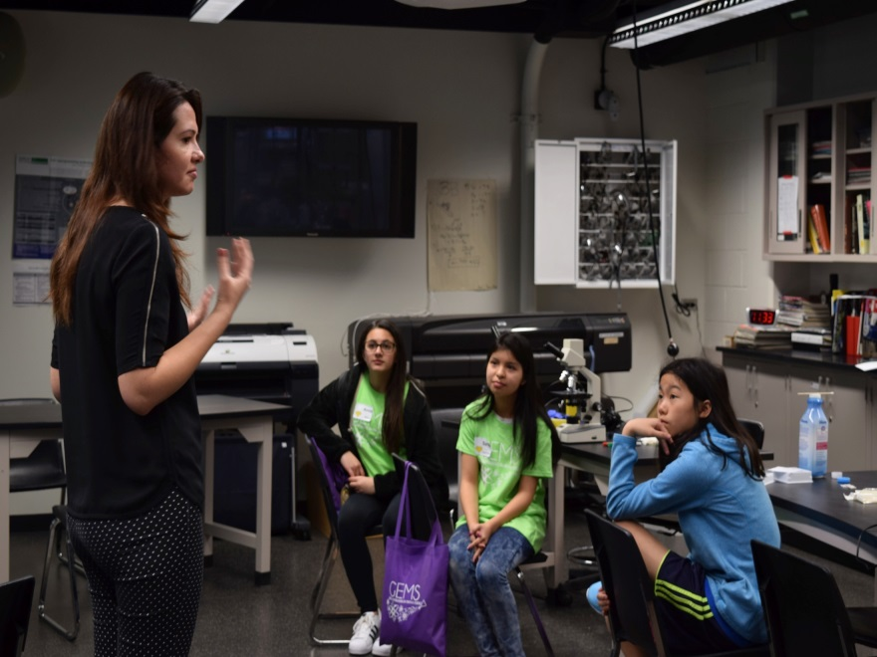
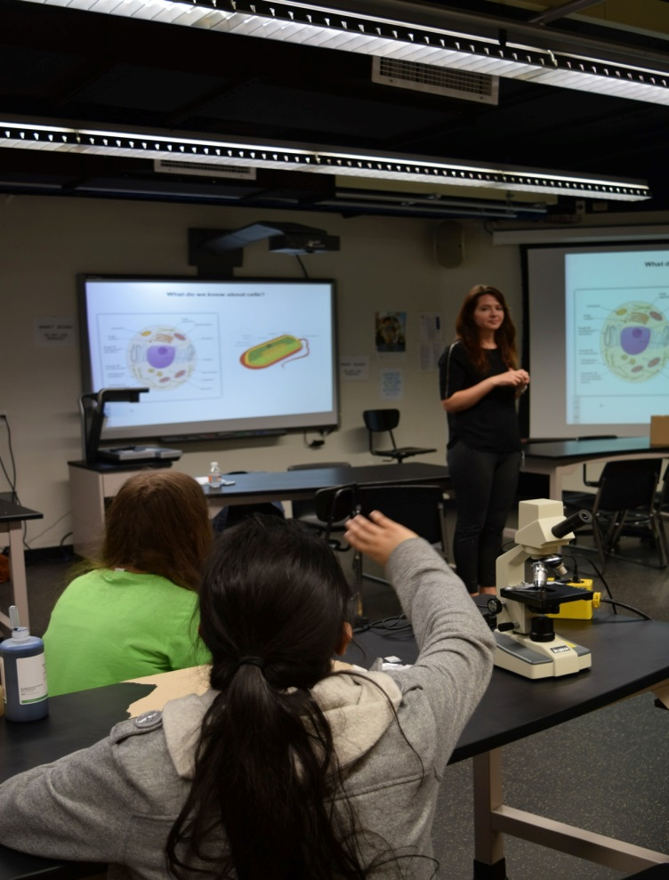
GEMS-Girls Empowered by Math and Science

Slide 14
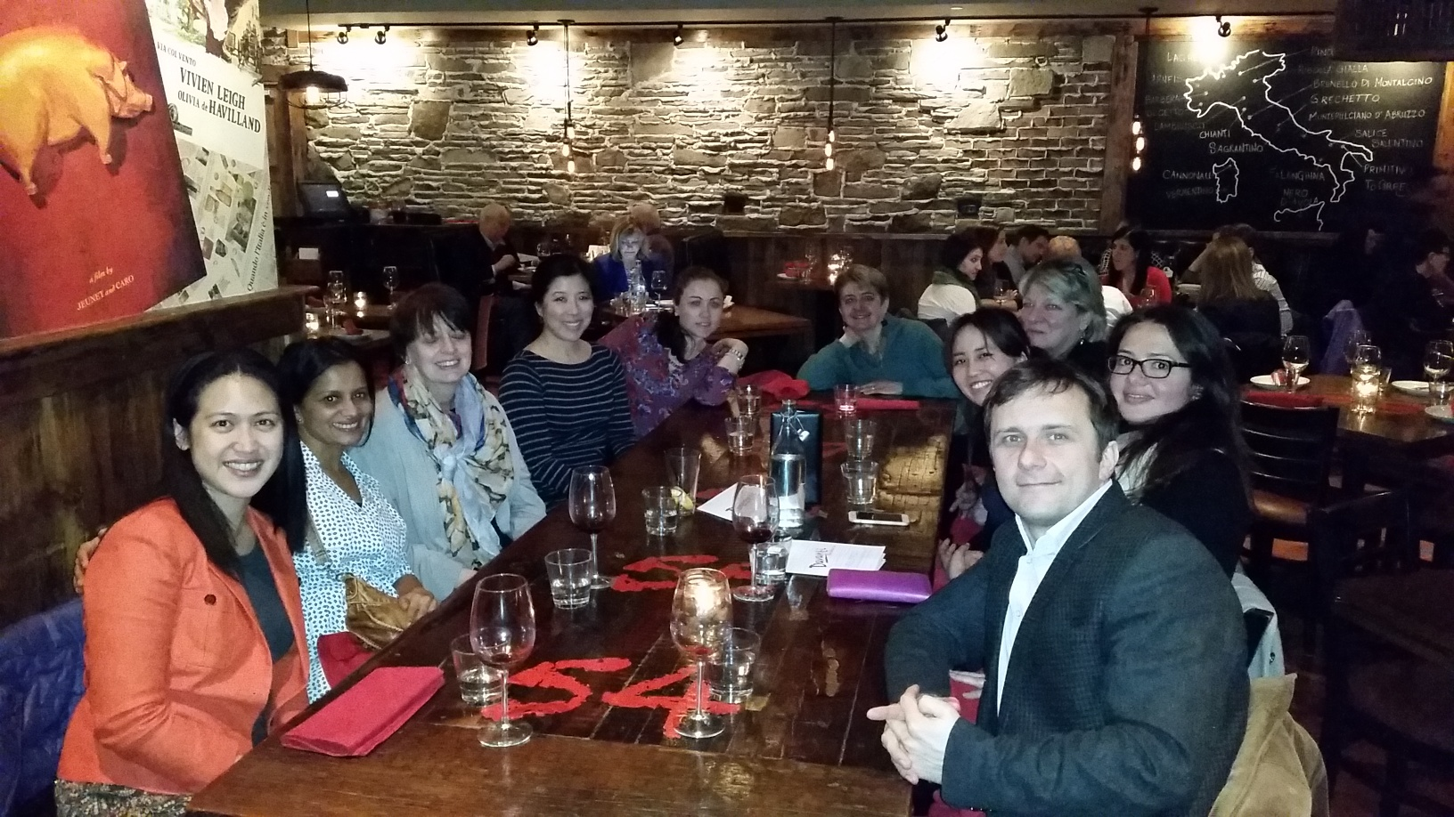
AWIS National Summit

Slide 15
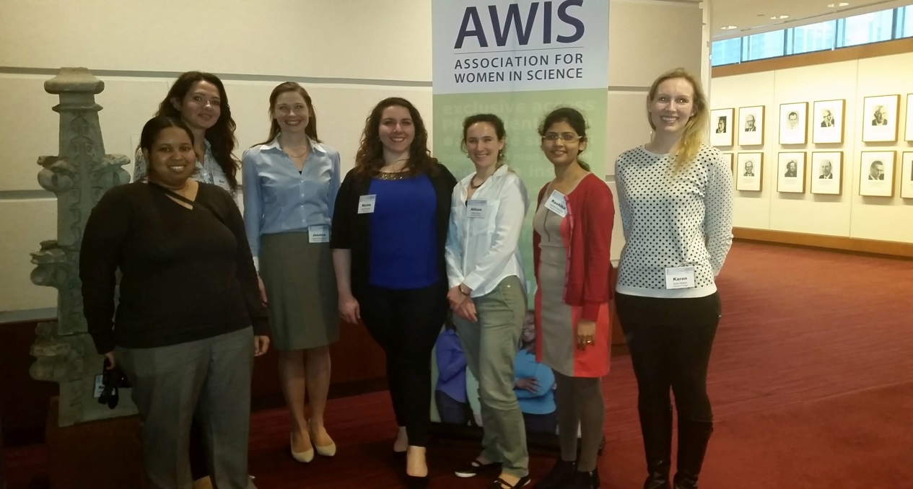
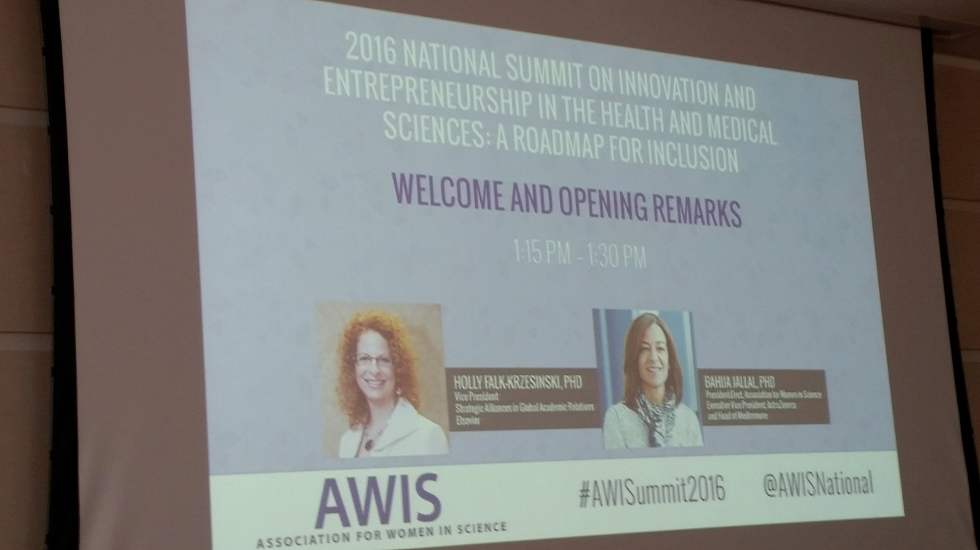
AWIS National Summit

Slide 16
Mentoring Circles Program
Pilot year
Purpose:
To create a network that 1) supports the personal and professional development of early career women in science and 2) provides experienced women in science the opportunity to contribute to and guide the growth of Chicagoland area women in science.
Participants:
17 total: 5 mentors, 12 mentees
Northwestern University, University of Chicago, Abbott, Damiano Group, Somera Consulting, Complete HealthVizion, The Savvy Scientist,
Biology, Tech Transfer, Science Communication, Consulting, Forensics, Medicine, Medical Devices, Education & Outreach, Chemistry, Nanotechnology

Slide 17
Mentoring Circles Testimonials
“Through the program I met two wonderful women with much different experiences than me who were able to give different perspectives and advice on topics of interest to me.”
“Our mentor was absolutely amazing. Also, I formed relationships with peers and now have other female scientist to talk to about various aspects of science, etc.”
“In addition to meeting the goals outlined by our circle, it has provided me with more confidence in other aspects such as networking and career development.”
“This was an AWESOME pilot program. I've learned so much from my mentees too!”

Slide 18
AWIS Chicago Annual Motivator and Innovator Award Dinner
Yamuna Krishnan, PhD
Department of Chemistry
University of Chicago
Miiri Kotche, PhD
Department of Bioengineering
University of Illinois at Chicago

Slide 19
AWIS Chicago Past and Present Partners

Slide 20
Join AWIS Chicago!
Not a member? Sign up TODAY!
Scientist of the Month series
Past and upcoming event information
Upcoming events of partner institutions
Discounts to AWIS events over non-members
Job postings and newsletter
LinkedIn and Facebook groups – discussions on a wide range of topics relevant to women in science
Visit us at www.awis-chicago.org. Find us on LinkedIn and Facebook!
Currently 70+ active members from all disciplines in various stages of their careers
Notes:
graduate students, retirees, post-docs, professionals in academia, education, medical communication, venture capital, non-profit organizations and more

Slide 21
Resources
http://www.awis.org
Career center for job postings
Research and analysis on the current state of women in science
Link to policymakers in Washington D.C.
Chicago chapter website
Career development resources
Ways to join and get involved
Notes:
graduate students, retirees, post-docs, professionals in academia, education, medical communication, venture capital, non-profit organizations and more

Slide 22
Questions?

